Slide 1
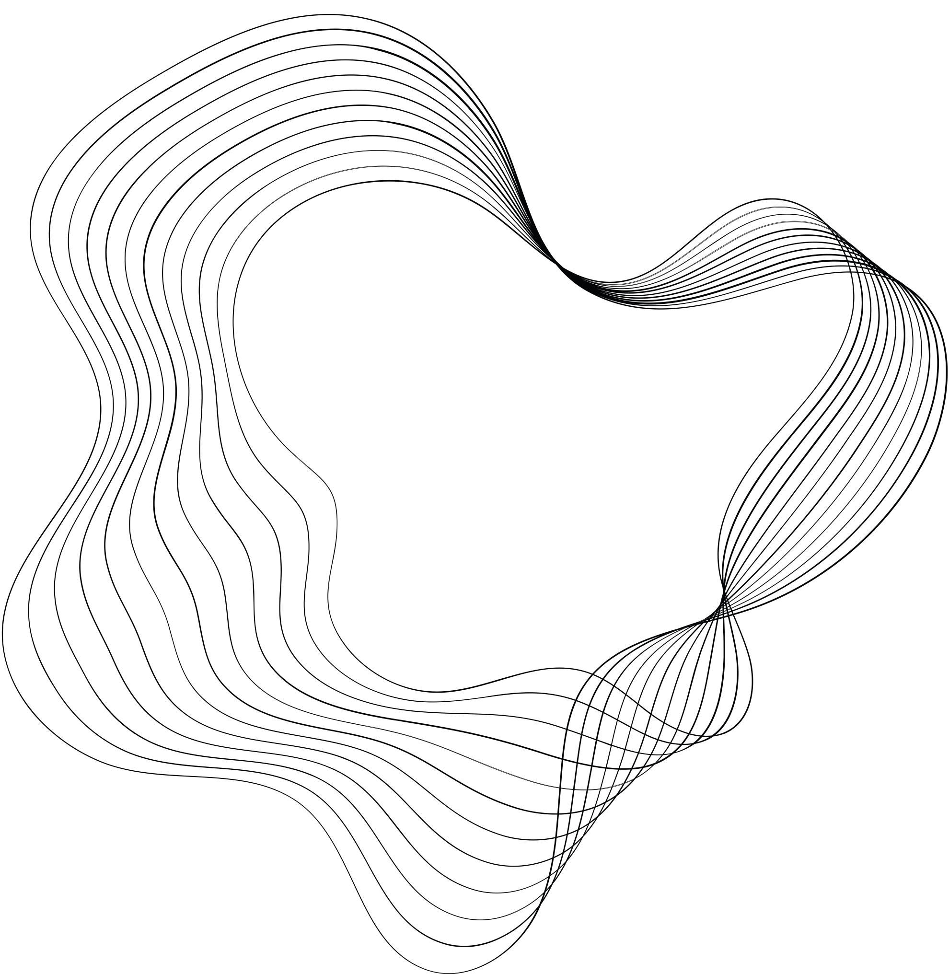

DS CAPSTONE PROJECT
QUANTITATIVE PORTFOLIO TRADING STRATEGY
V.S.
Algorithmic Trading Strategy
LEYAN DAI & YUXUAN LI

Slide 2

CONTENT
01
INTRODUCTION&SET UP
02
QUANTITATIVE TRADING STRATEGIES
03
ALGORITHMIC TRADING STRATEGIES
04
CONCLUSION

Slide 3

INTRODUCTION & SET UP

Slide 4
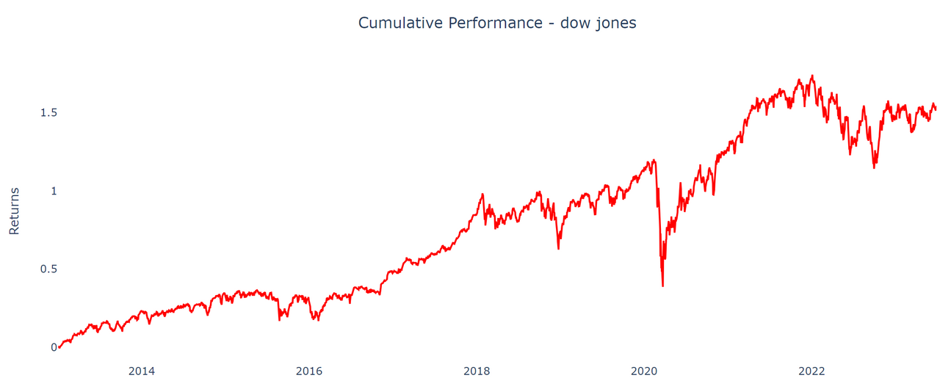

DOW JONES INDUSTRIAL AVERAGE (DJIA)
DJIA: a stock market index of 30 prominent companies listed on stock exchanges in the United States.
Our primary goal is to create an enhanced index based on the benchmark(DJIA).

Slide 5
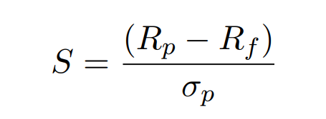

EVALUATION METRIC - SHARPE RATIO
Sharpe Ratio
assess the risk-adjusted return of a portfolio
S is the Sharpe Ratio
Rp is the annualized return of the portfolio
Rf is the risk-free rate, representing the return on a risk-free investment
σp is the annualized standard deviation of the portfolio’s returns, measuring risk.
0.49

Slide 6
QUANTITATIVE TRADING STRATEGIES

Slide 7

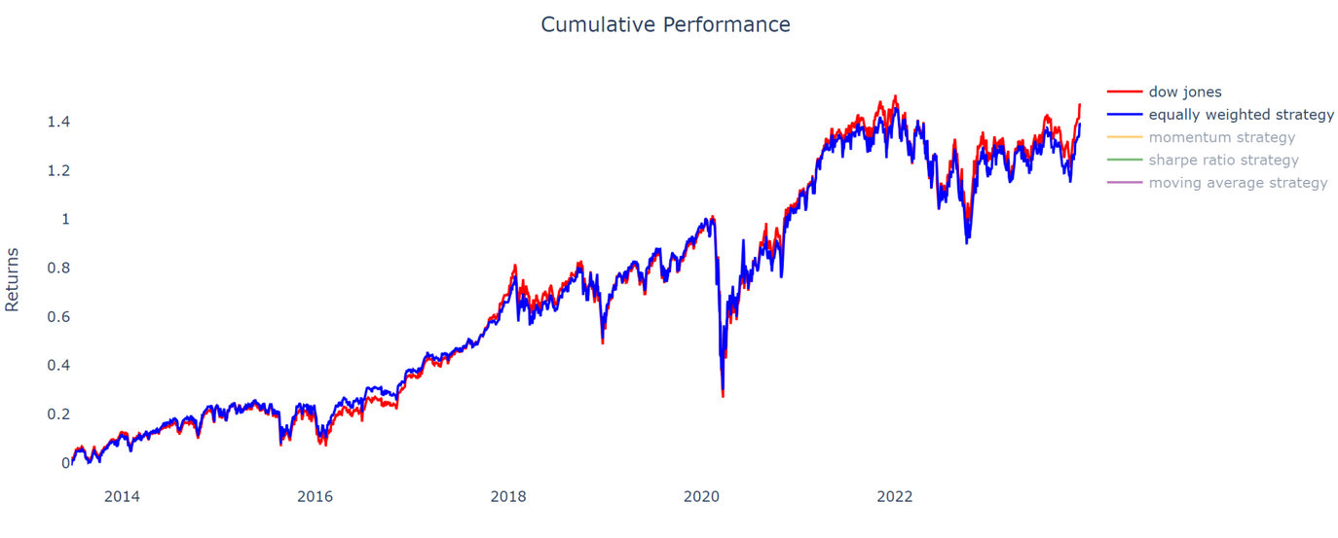
EQUALLY WEIGHTED TRADING STRATEGY
Equally weighted trading strategy assigns an equal weight to each individual stock within the Dow Jones Industrial Average (DJIA) regardless of their individual market capitalization.
Assign an equal weight to each individual stock within the Dow Jones Index regardless of their individual market capitalization.
Evaluation
Sharpe Ratio: 0.48
Annualized Return: 8.61%
Annualized Volatility: 16.98%

Slide 8
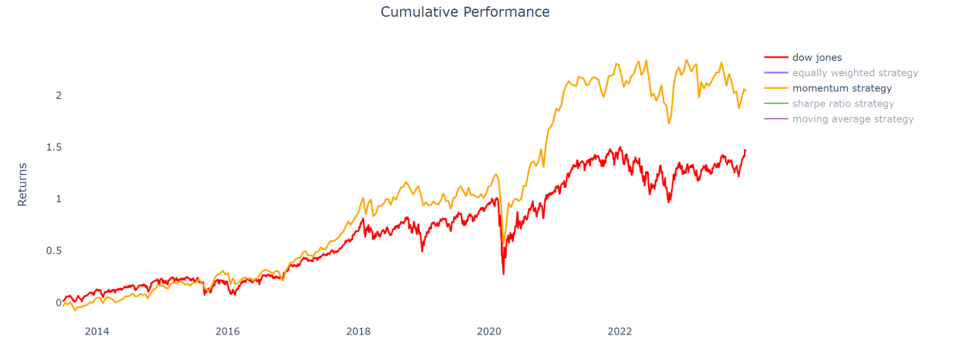
MOMENTUM TRADING STRATEGY
Trade stocks that have the highest return over a certain time period in the past
Optimal setting: reconstruct the portfolio every two weeks by buying 5 stocks that have the highest returns based on data from past half year
Equally weighted trading strategy assigns an equal weight to each individual stock within the Dow Jones Industrial Average (DJIA) regardless of their individual market capitalization.
Evaluation
Sharpe Ratio: 0.63
Annualized Return: 11.16%
Annualized Volatility: 17.00%

Slide 9
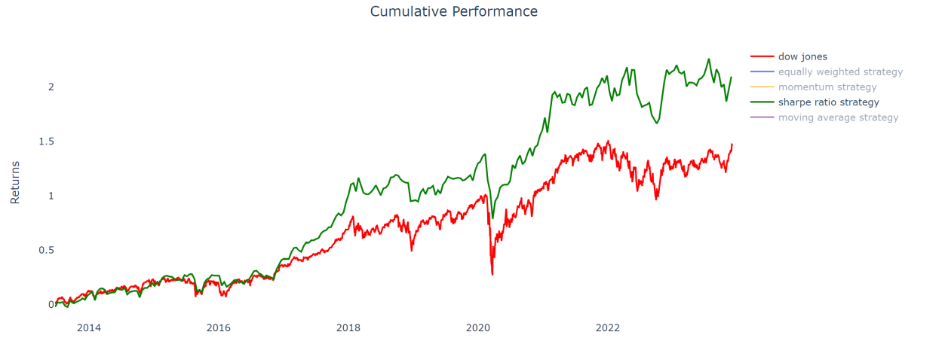
SHARPE RATIO TRADING STRATEGY
Trade stocks that have the highest sharpe ratio over a certain time period in the past
Optimal setting: reconstruct the portfolio every two weeks by buying 5 stocks that have the highest Sharpe ratios based on data from past half year
Equally weighted trading strategy assigns an equal weight to each individual stock within the Dow Jones Industrial Average (DJIA) regardless of their individual market capitalization.
Evaluation
Sharpe Ratio: 0.73
Annualized Return: 11.36%
Annualized Volatility: 14.88%

Slide 10
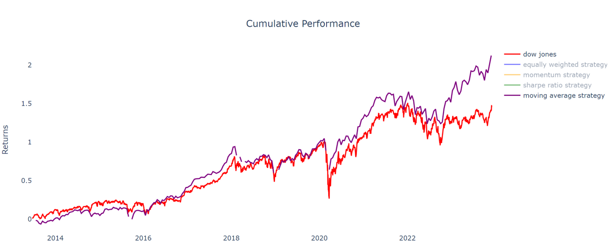
MOVING AVERAGE TRADING STRATEGY
Identify trends, potential entry points, and possible trend reversals..
Optimal setting: short term moving average(10 days) and long term moving average(110 days)
Buy stocks that have a higher short-term Moving Average than the long-term Moving Average
Equally weighted trading strategy assigns an equal weight to each individual stock within the Dow Jones Industrial Average (DJIA) regardless of their individual market capitalization.
Evaluation
Sharpe Ratio: 0.78
Annualized Return: 11.46%
Annualized Volatility: 14.06%

Slide 11
ALGORITHMIC: SUPERVISED LEARNING
Indicator pool: Relative Strength Index (RSI); Stochastic Oscillator; Williams %R; Moving Average Convergence Divergence (MACD); Price Rate of Change; On Balance Volume (OBV)
Target column: the difference between the closing price; Stand At Today
Model Setup: (2008-2015) Train: Test = 7: 3
Logistic Regression
Random Forest
Gradient Boosting
Accuracy = 0.5047
AUC = 0.5028
Optimized hyperparameters: {n_estimators = 1000; min_samples_split = 5; min_samples_leaf = 1; max_depth = 10; bootstrap = True}
Accuracy = 0.5371
AUC = 0.5118
Accuracy = 0.5173
AUC = 0.5044
Accuracy = 0.5060
AUC = 0.5002

Slide 12
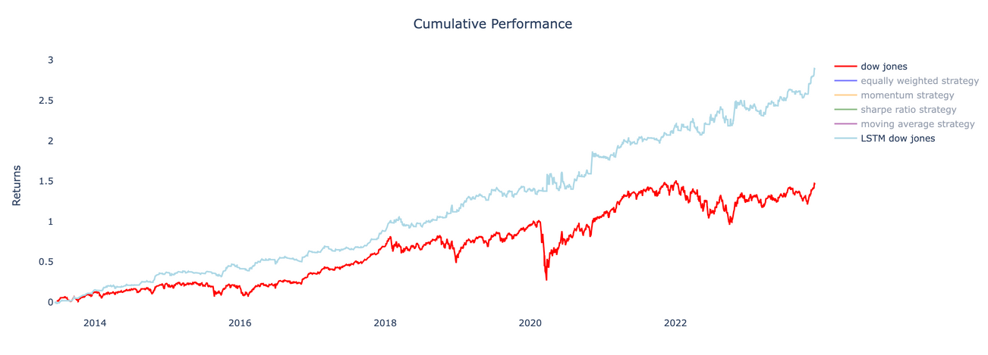
ALGORITHMIC:
DEEP LEARNING (LSTM)
Model Setup:
Number of Units = 10 3 Layers
Epoch = 20 Batch Size = 1
Baseline: Dow Jones Index
Short- and long-term Moving Average identified market entry/exit points
Model training data 2005-2012
train: test = 7:3
Use 2013 to 2023 data to back test
Cumulative return and evaluation metrics results comparison
Sharpe Ratio: 1.56
Annualized Return: 13.84%
Annualized Volatility: 8.56%

Slide 13
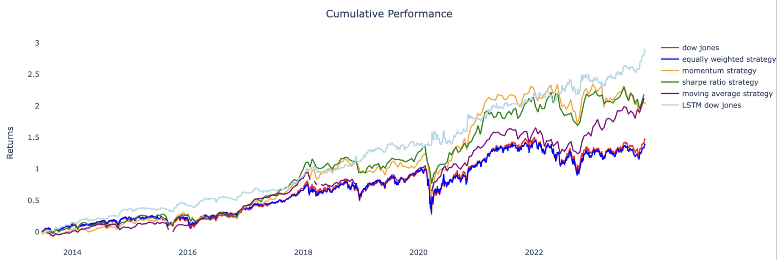
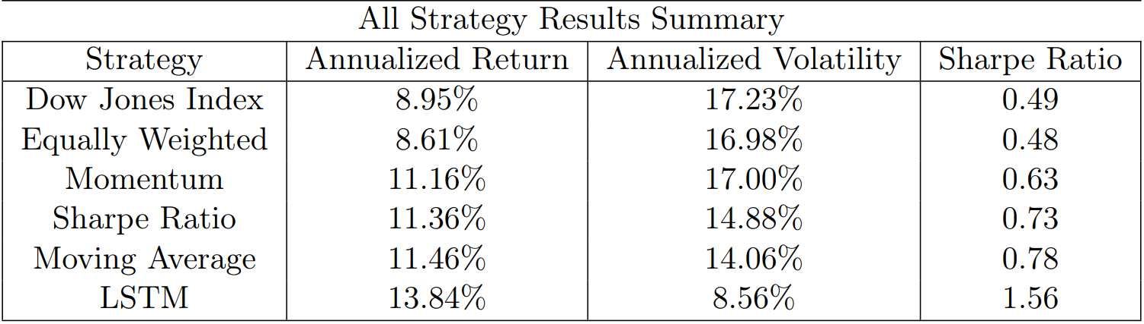
CONCLUSION

Slide 14
THANKS

